Slide 1
Respiratory health strategies across Europe
Carlos Robalo Cordeiro
Coimbra, Portugal
ERS President Elect

Slide 2
International Respiratory Coalition Summit

Slide 3
PRIMARY CARE I PRESENTIAL CONTACTS

Slide 4
DIAGNOSTIC AND THERAPEUTIC TESTS

Slide 5
OBSTRUCTIVE AIRWAYS DISEASE

Slide 6
Portuguese National Programme for
Respiratory Diseases
2012 - 2022
Notes:
Lisboa, 8 de Março de 2016
We live in an ageing world, in which better public health has resulted in longevity.
However, this demographic change has led to an epidemiological transition. The predominance of infectious diseases is shifting to non communicable or chronic disease.

Slide 7
MISSION
Reduce the burden of Chronic Respiratory Diseases
Reduce mortality from chronic respiratory disease
Reduce hospitalizations caused by chronic respiratory disease
2012- 2022
Objectives
Notes:
Aims:
All people, regardless of their age, to be included in strategies on detection and diagnosis, prevention, management and treatment.
Strategies against NCDs to recognise that including older people in prevention, promotion, management and care strategies will substantially reduce the health costs arising from rapidly ageing populations.

Slide 8
Portuguese National Programme for
Respiratory Diseases
OBJETIVES AND GOALS
2012-2016
Promote prevention, especially the 2nd and 3rd, with specific plans in 100% of the Health Regions
Contribute to early diagnosis, increasing accessibility to spirometry by 30% in Primary Health Care
Reduce hospitalizations for CRD in 10%
Reduce mortality from respiratory disease in 2%
…
Notes:
8

Slide 9
Portuguese National Programme for
Respiratory Diseases
Areas of intervention
Intervention Area by Pathologies
Transversal Intervention Areas
Communication and Social Mobilization Area
Scientific Coordinator for each area of intervention
Notes:
9

Slide 10
Portuguese National Programme for
Respiratory Diseases
Areas of intervention by pathologies
Pathologies of high
prevalence
Asthma
Chronic Obstructive Pulmonary Disease
Sleep Disease
Pathologies with a highly
differentiated approach
Cystic Fibrosis
Pulmonary Hypertension
Interstitial Lung Disease
Notes:
10

Slide 11
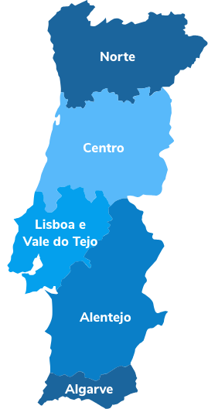
Portuguese National Programme for
Respiratory Diseases
REGIONAL COORDINATORS
ARS Norte
ARS Centro
ARS Açores
ARS LVT
ARS Alentejo
ARS Algarve
ARS Madeira
Notes:
11

Slide 12
Portuguese National Programme for
Respiratory Diseases
Transversal Intervention Areas
Smoking…
Allergies
Respiratory Infections
Pediatrics
Respiratory Care at Home
Environment Quality
Epidemiological surveillance
Scientific investigation
Notes:
12

Slide 13
Portuguese National Programme for
Respiratory Diseases
Strategies
Epidemiological surveillance
Primary , secondary and tertiary prevention
Treatment and monitoring
Communication and Social Mobilization
Notes:
13

Slide 14
Portuguese National Programme for
Respiratory Diseases
Monitoring Indicators
Indicators of Disease Management
Obstructive Airways Diseases
Notes:
14

Slide 15
Portuguese National Programme for
Respiratory Diseases
CLINICAL GUIDELINES
Notes:
15

Slide 16
Portuguese National Programme for
Respiratory Diseases
CLINICAL GUIDELINES
Notes:
16

Slide 17
Portuguese National Programme for
Respiratory Diseases
Primary Care – Diagnosis of
Asthma and COPD
Notes:
17

Slide 18
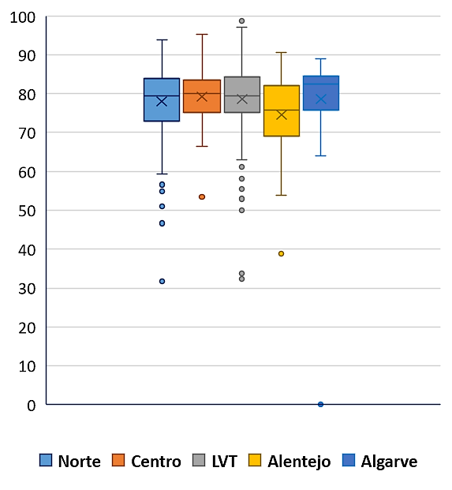
Portuguese National Programme for
Respiratory Diseases
Monitoring Indicators
Indicator 380 – Proportion of Asthma/COPD with diagnosis
±20% without diagnosis
(but with medication)
≈ 180.000 people
Ministério da Saúde. BI-CSP. https://bicsp.min-saude.pt/pt/biselfservice/Paginas/home.aspx (2022)
Notes:
18

Slide 19
Portuguese National Programme for
Respiratory Diseases
Standardized Admission Rate for
Asthma and COPD (/ 100 000)
Source: Health at a Glance 2021 - © OECD 2022
Notes:
19

Slide 20
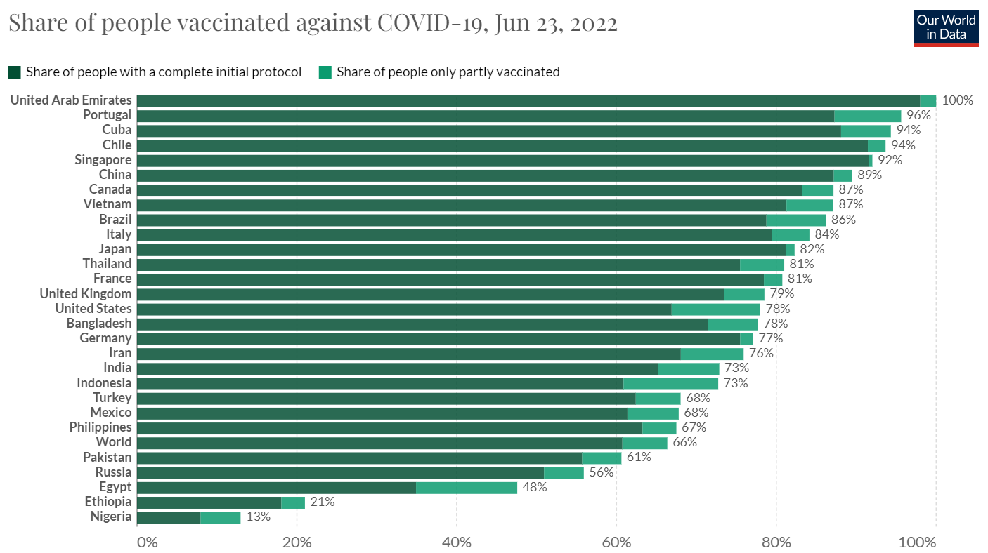

Slide 21
Vaccination rates of population ≥65 have been increasing, being estimated to have reached the 75% EU coverage goal in 2019/20
Evolution of the influenza vaccination coverage in people ≥65 (2008/09 – 2019/20) ^{(1,2)}
Influenza vaccination coverage in EU top 10 in people ≥65 (2017/18) ⁽³⁾
WHO target: 75%
76%
United Kingdom
73%
Netherlands
64%
68%
66%
65%
65%
64%
62%
66%
Portugal
61%
62%
Ireland
58%
59%
59%
58%
61%
Spain
56%
53%
52%
51%
51%
Malta
56%
48%
50%
50%
45%
Italy
52%
43%
France
50%
2008/ 2009
2009/ 2010
2010/ 2011
2011/ 2012
2012/ 2013
2013/ 2014
2014/ 2015
2015/ 2016
2016/ 2017
2017/ 2018
2018/ 2019
2019/ 2020
Sweden
49%
Finland
48%
Portugal: ≥65 years old (1)
Portugal: ≥65 years old (2)
Source: (1) Eurostat (2) Annual reports from Vacinometro (project from the Sociedade Portuguesa de Pneumologia (SPP) and Associação Portuguesa de Medicina Geral e Familiar (APMGF), with support from Sanofi. Data supplied by Sanofi. (3) Last year with more available data per country. List of countries with data published by Eurostat.
BARI Study | Key results for the burden of Influenza in Portugal - Expert panel

Slide 22
Notes:
22

Slide 23
RESULTS 1st March 2022
Percentage of vaccinated individuals in the recommended groups
> 65 years old
88,3%
Chronic Disease
83,4%
60-64 years
53,3%
Health Professionals
64,4%
Pregnant
60,2%
Sample information:
The sample in question is associated with:
A margin of error of ±1.7% for a 95% CI in the total sample (n=3226);
A margin of error of ±3.1% for a 95% CI within the Target 65 years or more (n=999).
A margin of error of ±3.5% for a 95% CI within the Chronic Patients Target (n=767);
A margin of error of ± 3.7% for a 95% CI within the Target Health Professionals in Contact with Patients (n=685);
A margin of error of ± 3.5% for a 95% CI within the Target 60-64 years (n=773);
A margin of error of ± 3.7% for a 95% CI within the Pregnant Target (n=714);
Notes:
23

Slide 24
Froes F, Carmo M, Lopes H, Gomes C, Martins M, Guzman C, Bricout H, Correia de Sousa J, Rabaçal C, Raposo J, Robalo Cordeiro C
The primary goal of the study is to describe the evolution of the annual direct burden from hospitalizations for influenza in Spain and Portugal, from an epidemiologic and economic perspective, over a period of 10 years.
The secondary goals of the study are to:
Describe the evolution of the seasonal influenza vaccination coverage;
Describe the evolution of the incidence and mortality of influenza, through national surveillance data;
Describe the evolution of the direct cost from primary care consultations for influenza;
Describe the characteristics of patients hospitalized for influenza – and of their episodes;
Estimate the evolution of the potential indirect cost of influenza due to productivity loss (exploratory goal);
Describe the evolution of sales of pharmaceutical products likely to be used for influenza-like illness (ILI) (exploratory goal);
Analyze the association between AMI and influenza (exploratory goal);
Abstracts ESPID May 2022, ESWI June 2022
Notes:
24

Slide 25
Overall, an increase of hospitalizations for influenza in population aged 65 years old or more was observed over the last 2 epidemic seasons
Results are coherent with literature finding higher impact on elderly population for strain A(H3N2) and evidence of higher excess mortality among adults and elderly in season 2017/18
Share of hospitalizations for influenza per broad age group and year (2008/09 – 2017/18) ⁽¹⁾
3,007
2,770
9%
2,189
1,938
60%
1,622
55%
32%
67%
1,363
91%
942
951
39%
761
757
29%
44%
400
20%
481
26%
68%
40%
45%
36%
80%
42%
74%
71%
56%
33%
61%
64%
58%
2008 /09
2009 /10
2010 /11
2011 /12
2012 /13
2013 /14
2014 /15
2015 /16
2016 /17
2017 /18
10 yrs mean
3 yrs mean
<65
≥65
AH3
B/Yamagata
IQVIA/ IASIST hospitalization database, for mainland Portugal. Epidemic season includes hospitalizations between September n and June n+1, both inclusive.
Note: w/ - with; w/o – without.
BARI Study | Key results for the burden of Influenza in Portugal - Expert panel
Notes:
25

Slide 26
Mortality in Portugal Global Burden of Disease 2019
Pneumonia Eurostat (2013-2015)
4,05%
11,1%
14,34%
7,11%
5,32%

Slide 27
Ageing: a health challenge
for every 100 young people (< 15 years old)
in 2011, 127.6 elderly people
in 2019, 163.2 elderly people

Slide 28
Portuguese National Programme for
Respiratory Diseases
Main Causes of Respiratory Mortality
TOTAL
PNEUMONIA
COPD
Notes:
28

Slide 29
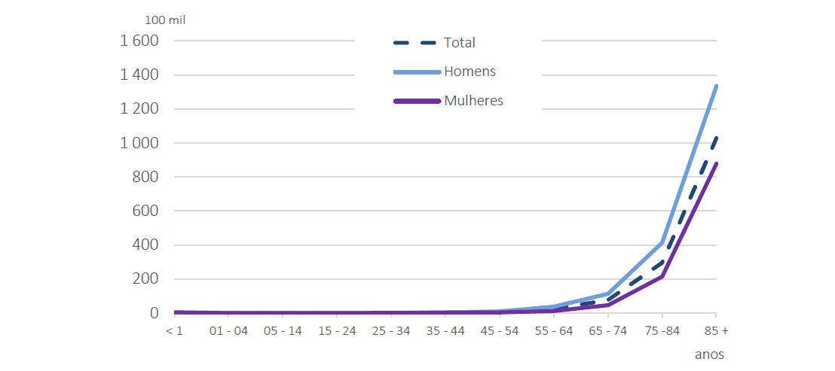
COVID - 19 Mortality Rate- 2020
As of March 2020, there have been cases of deaths caused by COVID-19, with a total of 7,125 deaths by the end of the year, representing 5.8% of all deaths.
According to WHO standards, deaths from COVID-19 were not classified or included in the respiratory diseases, constituting a set of diseases apart.
Notes:
29

Slide 30
Evolution of Mortality in Portugal INE (1988 to 2013)
Notes:
30

Slide 31
Portuguese National Programme for
Respiratory Diseases
Main Causes of Mortality
In 2020, respiratory diseases caused 11,266 deaths, 8.0% less than in the previous year, and in reduction in total deaths (from 10.9% in 2019 to 9.1% in 2020)
Notes:
31

Slide 32
Portuguese National Programme for
Respiratory Diseases
Conclusions
Since 2012, as a consequence of the better quality of care provided, health gains have been made concerning reducing total Respiratory Mortality (excluding lung cancer) and reduction of the standardized rate of hospitalizations for Asthma and COPD.
Despite the negative impact of the COVID 19 pandemic on accessibility to face-to-face consultations in Primary Health Care, slight improvements were observed during 2021, regarding the diagnostic capacity of the two main chronic respiratory diseases (Asthma and COPD).
Notes:
32

Slide 33
Portuguese National Programme for
Respiratory Diseases
Conclusions
The COVID‑19 pandemic has exposed the insufficient preparation of countries to cope with major public health emergencies.
The COVID‑19 pandemic, as well as other global threats such as climate change and air pollution, have brought to light the need for effective and inclusive multilateralism and co‑ordinated actions at national, European and global levels to effectively and equitably deal with these issues.
Notes:
33

Slide 34
NATIONAL HEALTH PLAN 2021-2030

Slide 35
NATIONAL HEALTH PLAN 2021-2030
NEW TYPOLOGY OF HEALTH PROBLEMS WITH A RISK POTENTIAL ON THE RISE
Problems associated with climate change
Viral infections with pandemic potential
Avoidable mortality associated with extreme temperatures
Public health emergencies, such as natural disasters

